Slide 1
AWS Billing Dash
Abilash s r

Slide 2
Nothing is Free in the world!
Billing is globally specific
We are using free account 1year free tier account with some benefits.
Important session because all the resource usage we need to study to avoid over charge.
One place to see the cost accurs
You can able to calculate free tier usage/region and service usages
Whenever login just visit billing console and analyse the usage for couple of min
You can configure –non recurring payments
Always look out the cost while configuring any services

Slide 3
AWS SNOW FAMILY
Data Migiration From On premisis to Cloud
Data Migration from Cloud to On premisis
Think about 100TB data will transfer over internet
Snow ball family plays a major role in data migration

Slide 4
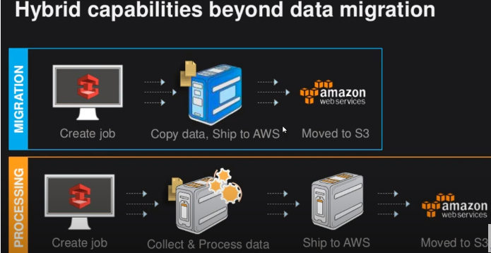

Slide 5
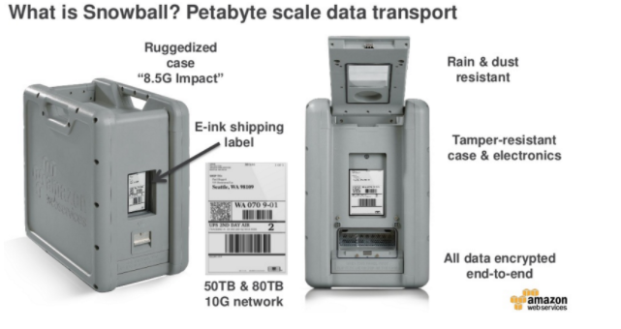

Slide 6
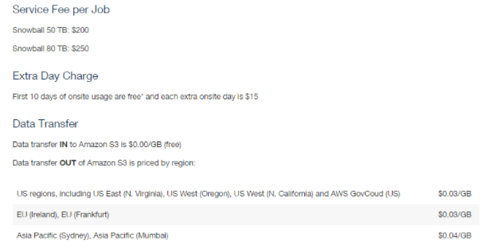

Slide 7
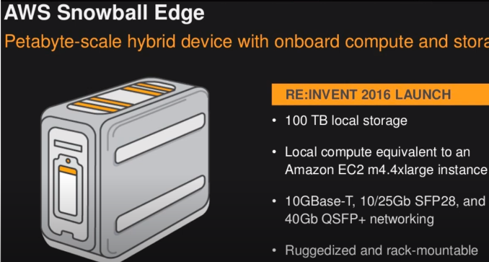

Slide 8
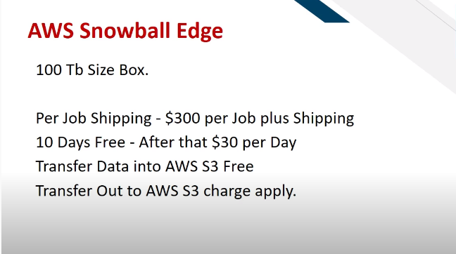

Slide 9
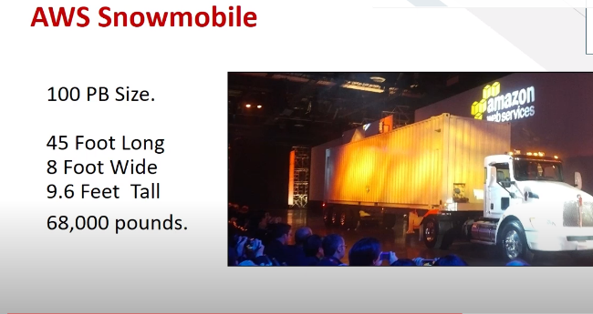

Slide 10
